Slide 1
Reactions 11
Orbit Model of the Nucleus

Slide 2





















































Slide 3





































Slide 4
































This is similar to how electrons can propagate long distances without scattering in metals, where electron density is 10^22/cm³.

Slide 5








































Slide 6


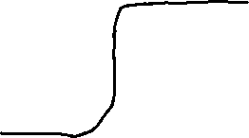






























Slide 7









































LL3 sec 33 problem 2 and sec 118 “The shell model”.

Slide 8




LL3 sec 118 and Meyerhof give different groupings and different magic numbers

Slide 9







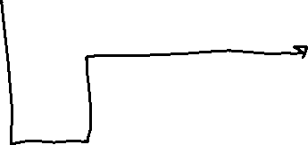
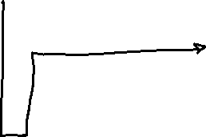










Slide 10





































Slide 11





























double
nucleus

Slide 12






























also a doubly magic nucleus

Slide 13


































Slide 14
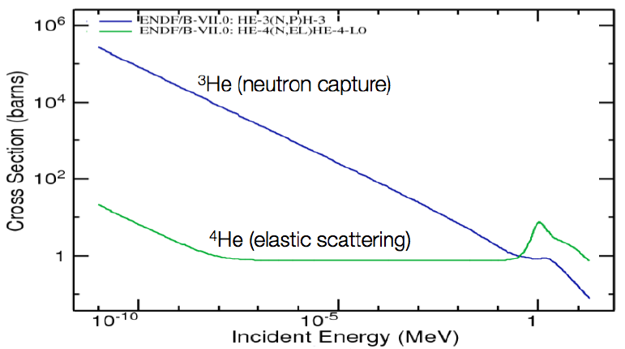


for fast neutron detection, this cross section exhibits a peak that is located at roughly 1MeV, nicely matching the peak emission of fission neutrons. In this work 4He is used as a fast neutron detection medium, exploiting the relatively large elastic scattering cross section in the energy range of fission neutrons. In an elastic scattering interaction, energy is transferred from an incoming neutron to a 4He nucleus. The neutron is not absorbed in the process. R Chandra, G Davatz, H Friederich, U Gendotti and D Murer, “Fast neutron detection with pressurized 4He scintillation detectors,” J. Instrumentation 7, C03035 (2012) (ETH Zurich).

Slide 15







































Slide 17

Same as Fermi values.
LL3 sec 33 Prob 4
Ways to get different magic numbers

Slide 18







Empirical evidence of magic numbers. LL3 list. 28 is on Meyerhof’s rounded square well grouping.

